Slide 1
Security Pitfalls for Workload Identities in Azure

Slide 2




Passwords & Passwordless
Trusted Location & Conditional Access
Trusted Devices & Authenticators
Sign-in Logs & Risk Policies
Notes:
When talking about authentication, we always talk about these things. But not…

Slide 3
We’re
not
talking about
users

Slide 4
We’re
talking about
Unmanaged Identities

Slide 5

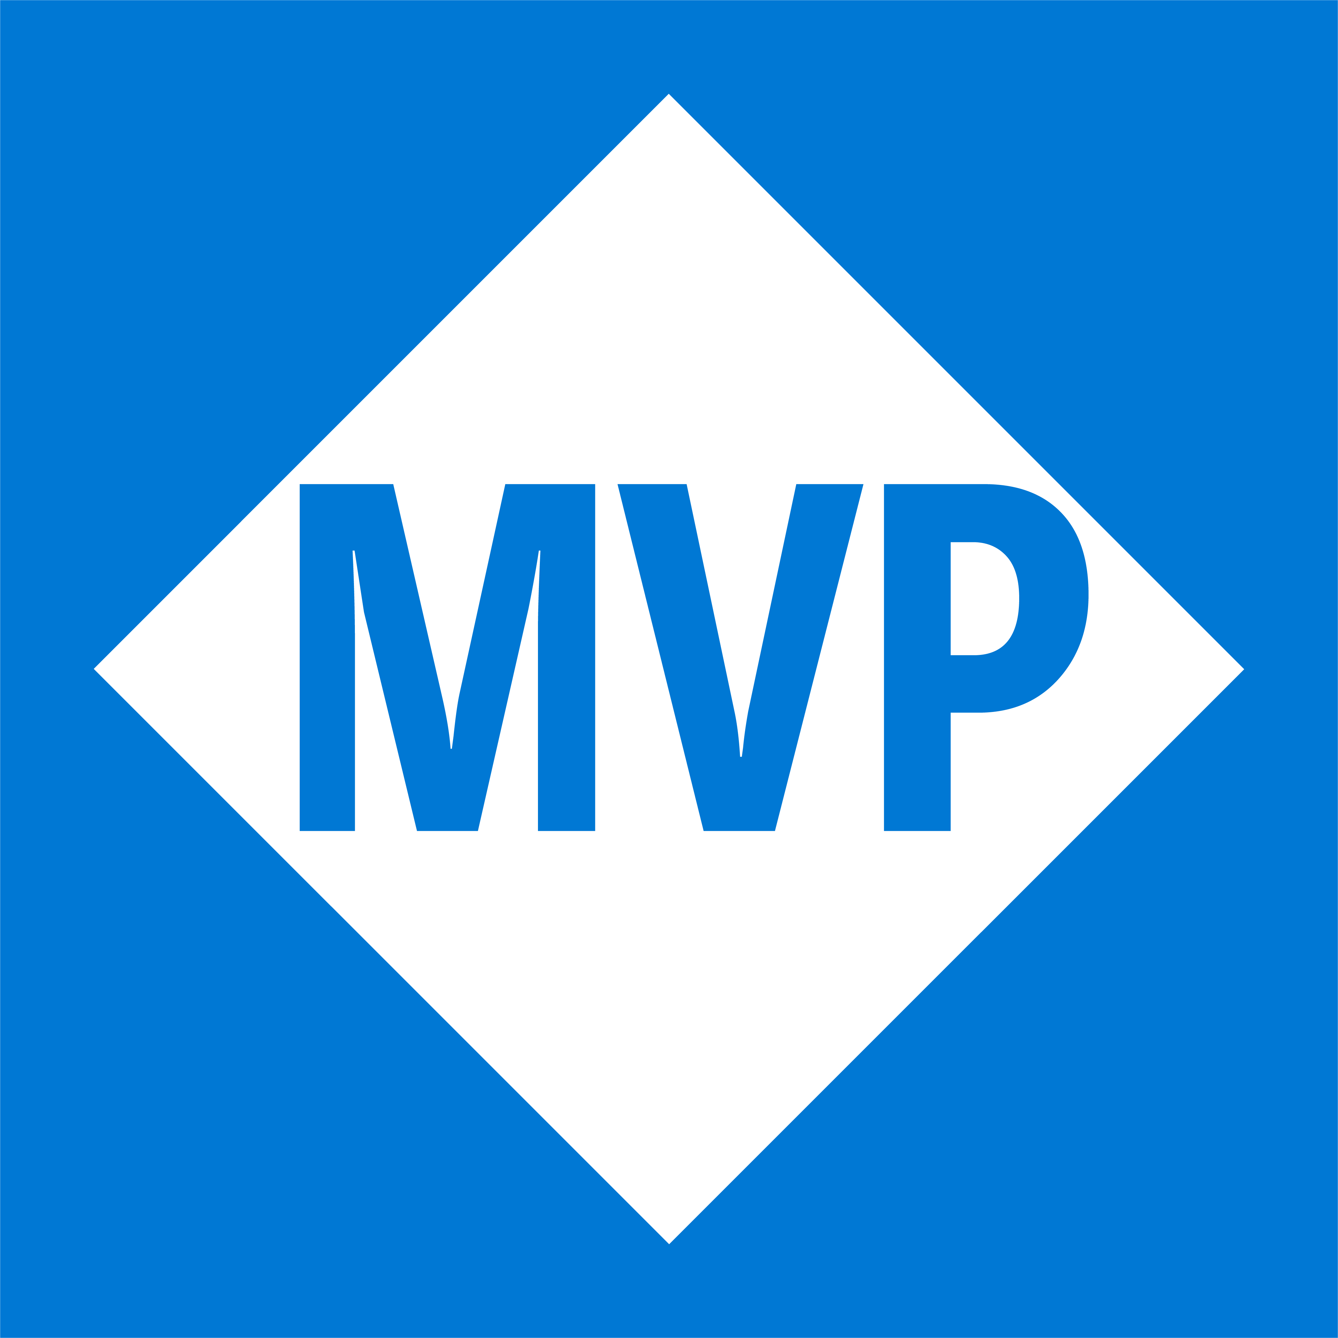
Emanuel Palm
@PalmEmanuel
🧙☕🍰🧗🥏
💙 Everything-as-Code
📦 Makes modules & tools
📃 Fan of Open Source
☁️ Blogs at pipe.how

Slide 6
“We have too many Service Principals”
Notes:
That’s not true, you can have up to 500 000 objects in Entra, and even more if you ask Microsoft nicely.

Slide 7
PLACEHOLDER – THANK SPONSORS AND REMINDER TO EVALUATE THE SESSION AFTERWARDS

Slide 8
Session Overview
Graphics with arrows between each block of the session
Workload Identity Types
Security pitfalls
Summary
Questions

Slide 9
Notes
If you’re still using AzureRM, stop. It’s deprecated on the 29th of this month, and it stores all tokens unencrypted on your machine!
When talking about user authentication. If we enable MFA and PIM, we’ve prevented a lot of threats. I don’t see people as worried about their passwords leaking anymore. To be honest, that partly feels like a solved problem. Passwordless and MFA is great.
A slide talking about MFA and PIM, and how we don’t have the option of that level of security for workload identities – we need to be restrictive with what access we give to non-personal accounts.
Workload Identity Types
Is there a need for a slide explaining differences between the types, other than credentials?

Slide 10
Identity Types
Workload
“A collection of application resources, data, and supporting infrastructure that function together towards a defined business goal.”
- Microsoft Azure Well-Architected Framework

Slide 11
Identity
Workload
“In Microsoft Entra, workload identities are applications, service principals and managed identities.”
- Microsoft Entra Workload ID documentation

Slide 12



Identity
Workload
Types
App Registration
Enterprise Application
Application
Service Principal

Slide 13

Entra Tenant
Application
Service Principal

Slide 14
Entra Tenant
Application
Service Principal

Slide 15

Identity
Workload
Types
User-Assigned Managed Identity
System-Assigned Managed Identity
Application
Service Principal

Slide 16
Application
Service Principal
User-Assigned Managed Identity
System-Assigned Managed Identity

Slide 17

Federated Credential
🪪
Secret📝
Certificate🔑
Application
✅
✅
✅
Service Principal
✅
✅
❌
User-Assigned Managed Identity
❌
✅
System-Assigned Managed Identity
❌
❌

Slide 18
Security Pitfalls list
Principle of least privilege
Using Client Secrets (is bad)
Credential Management (if we really need them, use secret storage like KV and ensure that the process to issue new secrets etc is safe and controlled. Don’t email it!) Rotate credentials often, and if you do store secrets, think of also securing the storage fully
Not ensuring traceability (if I have access to of credentials as the app, it shouldn’t be possible for me to use it without my name showing (malicious insider)). Also audit and alerting for reading sensitive secrets if it’s not done by an identity that should
User-Assigned Managed Identities (unintentional assigning & Azure Policy works for them!)
Shared identities between services
Not using Workload ID (Conditional Access – IP ranges (if the identity should only be used from on-prem, limit it, if it should only be used from west europe Microsoft-hosted agents in Azure DevOps, limit it etc) & Risky sign-ins)
No clear life cycle process for all types (if we have clear on&offboarding for users, why would we allow these potentially less secure identities to be without?)
Accountability and ownership for the identities
Access reviews
Securing the entire supply chain and pipeline (doesn’t matter if the identity can only be used from a pipeline if that pipeline isn’t locked down too, and no one can override branch policies etc)
Monitoring sign-ins and logs for anomalies
Too long access token lifetime policies (use proper refresh flows instead)
Not restricting who has access to use the workload identities

Slide 19
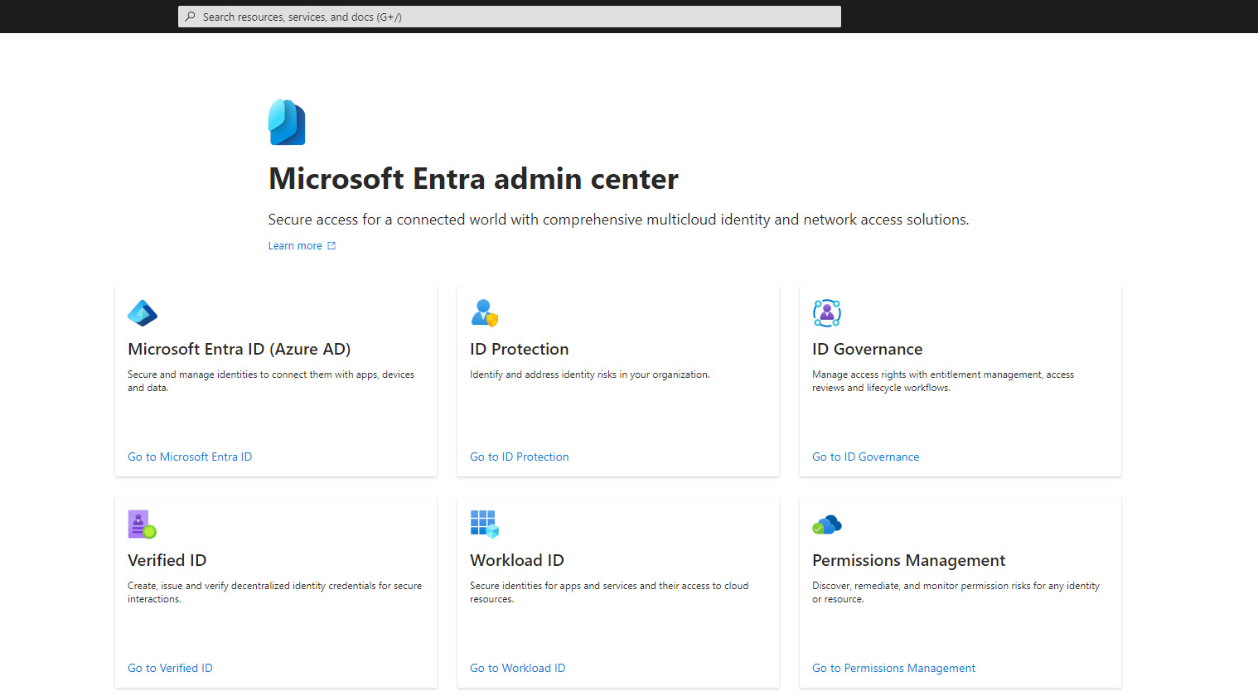
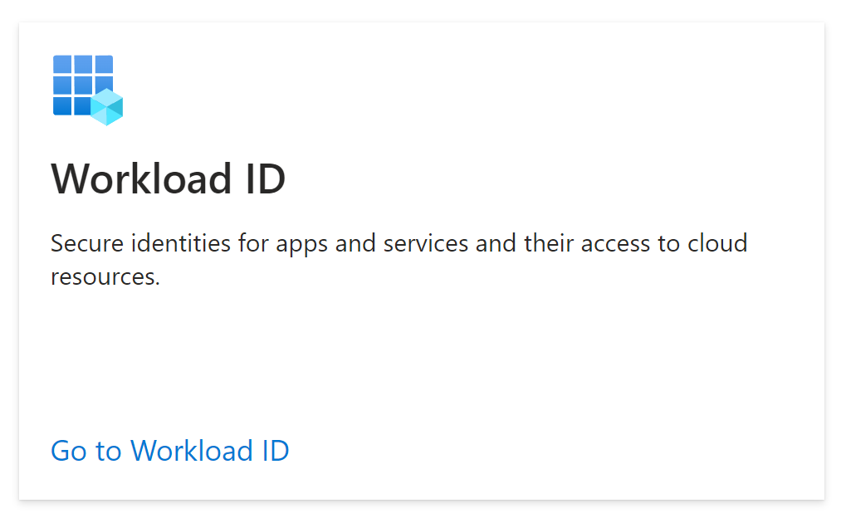

Slide 21
Quiz time! Which solution is more secure? (Give the audience 10 seconds and point to a direction left/right, then say: it depends)
Service Principal with Federated Credential, used in a service connection in Azure DevOps
Can all pipelines use it?
Is it automatically triggered when new code is committed, and who can contribute with code?
Can someone override branch policies?
Who can add credentials to the service principal?
Is the pipeline running on Microsoft-hosted agents, or self-hosted? Can we set up Conditional Access policies based on Location?
User-Assigned Managed Identity used for a web app, assigned to a VM in Azure
Who can log into the VM?
Can anyone assign the identity to more resources?

Slide 22



Thank you!
Questions?
pipe.how
@PalmEmanuel

